Slide 1
Kraken, Kraken2 & Bracken
Thomas Nordahl Petersen

Slide 2
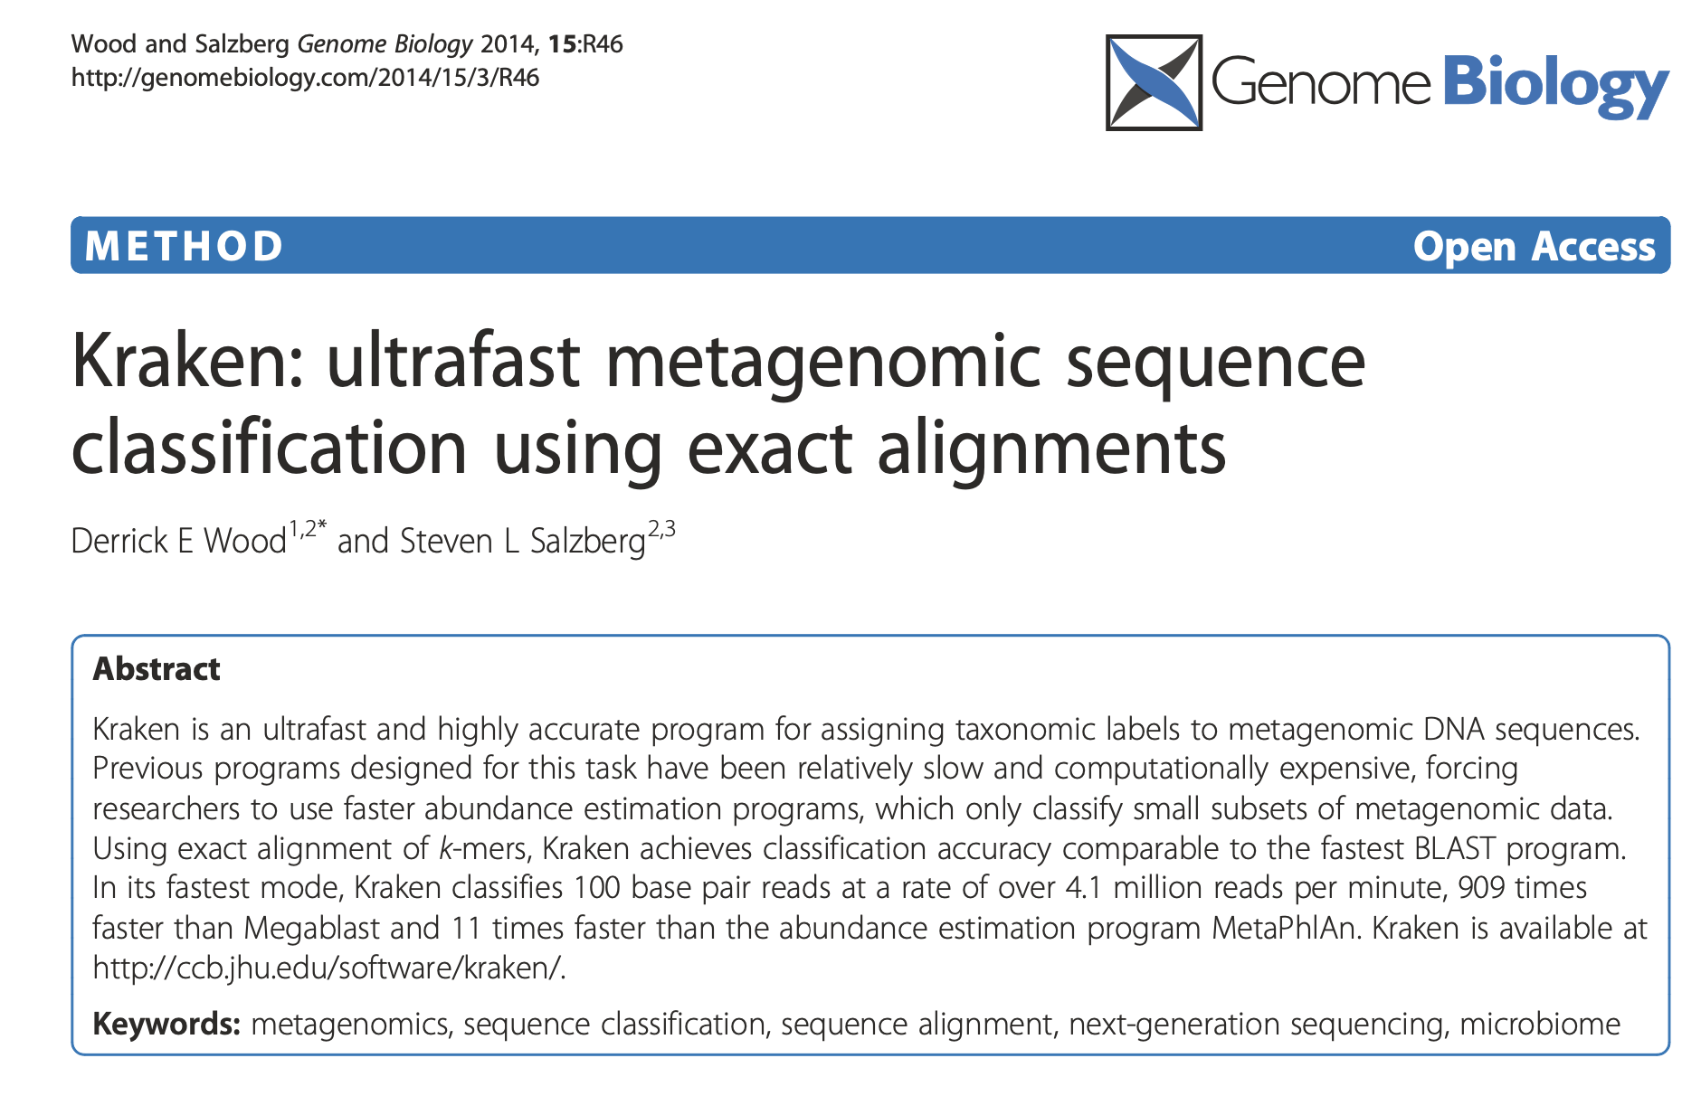
Kraken

Slide 3
Reference based or de-novo assembly
Reference based mapping/alignment
A reference database is needed
You can only find sequences that are in the database
You can a relation between your input sequence and the hit in db
Blast is a reference based alignment methods performing local alignments
De-novo assembly
No database is needed
You input sequences (reads) are assembled into contigs
No assignments i.e. a contig is not assigned to a specific organism
Blast – Basic Local Alignment Search tool
Typically 1 query sequence is searched against a database of millions of sequences
Notes:
----- Meeting Notes (10/2/13 14:19) -----
When the sequencing is done, you get your output…
----- Meeting Notes (10/2/13 14:27) -----
In this next section I will gow throug the output data.
The sequence data is outputtet as fastq files.
And what is fastq files?
It is a fasta file with quality scores!
So this is an example of a fastq file.

Slide 4
Metagenomics
Millions of reads
How can we assign an annotation to ”all” reads very fast
Kmers i.e. convert a big sequence database where we know the origin of
each sequence
>AP009384.1 Azorhizobium caulinodans ORS 571 DNA, complete genome
CATCCAGAGCGGCGGGGTCTTCTGCGGGAAGCCGTCCAGCACGTTCAGAAACGGGGAGGG
CTTGGCCCTAAGCTCGCTCATGCCCACACACCCTCATCAAACAAGAATCTCTTAGAAAAG
AGAGTCGTTAGTGTCTTAACGGTTGATTAACTAGTCGCGCGGCGATCGACAACCGATCCA
CAAACGGACACGGCGGCGCACCCCGATTCACAGGGGCGGGAAAAGGCCAAAAACCGCCGG
>AE013218.1 Buchnera aphidicola str. Sg (Schizaphis graminum), complete genome
ATGTCAAAGTCGTATTTAAAAAATTTTGATGTTATTGTTATTGGTGGAGGGCATGCTGGC
ACTGAAGCTGCAGCAGCCTCTGCAAGAGTAGGTTGTAAAACATTATTATTAACTCAAAAA
ATAACTGATATAGGTGTATTATCTTGCAATCCTGCTATCGGAGGAATAGGTAAAAGTCAT
TTGGTAAAAGAAATAGATGCTTTAGGTGGTTTGATGGCCAGAGCTATTGATTATTCAGGA
ATTCAGTTTAGAGTTTTAAATTCTAAAAAGGGTCCTGCTGTAAGGTCAACTAGAGCTCAA
Notes:
----- Meeting Notes (10/2/13 14:19) -----
When the sequencing is done, you get your output…
----- Meeting Notes (10/2/13 14:27) -----
In this next section I will gow throug the output data.
The sequence data is outputtet as fastq files.
And what is fastq files?
It is a fasta file with quality scores!
So this is an example of a fastq file.

Slide 5
Metagenomics
Millions of reads
>AP009384.1 Azorhizobium caulinodans ORS 571 DNA, complete genome
CATCCAGAGCGGCGGGGTCTTCTGCGGGAAGCCGTCCAGCACGTTCAGAAACGGGGAGGG
CTTGGCCCTAAGCTCGCTCATGCCCACACACCCTCATCAAACAAGAATCTCTTAGAAAAG
AGAGTCGTTAGTGTCTTAACGGTTGATTAACTAGTCGCGCGGCGATCGACAACCGATCCA
CAAACGGACACGGCGGCGCACCCCGATTCACAGGGGCGGGAAAAGGCCAAAAACCGCCGG
>AE013218.1 Buchnera aphidicola str. Sg (Schizaphis graminum), complete genome
ATGTCAAAGTCGTATTTAAAAAATTTTGATGTTATTGTTATTGGTGGAGGGCATGCTGGC
ACTGAAGCTGCAGCAGCCTCTGCAAGAGTAGGTTGTAAAACATTATTATTAACTCAAAAA
ATAACTGATATAGGTGTATTATCTTGCAATCCTGCTATCGGAGGAATAGGTAAAAGTCAT
TTGGTAAAAGAAATAGATGCTTTAGGTGGTTTGATGGCCAGAGCTATTGATTATTCAGGA
ATTCAGTTTAGAGTTTTAAATTCTAAAAAGGGTCCTGCTGTAAGGTCAACTAGAGCTCAA
Each organism name is converted to a number – a taxid number and assigned to a taxa
Notes:
----- Meeting Notes (10/2/13 14:19) -----
When the sequencing is done, you get your output…
----- Meeting Notes (10/2/13 14:27) -----
In this next section I will gow throug the output data.
The sequence data is outputtet as fastq files.
And what is fastq files?
It is a fasta file with quality scores!
So this is an example of a fastq file.

Slide 6
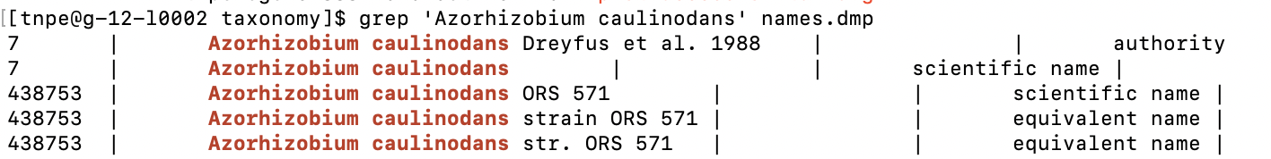
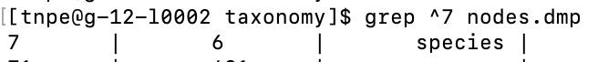
Metagenomics
Millions of reads
>AP009384.1 Azorhizobium caulinodans ORS 571 DNA, complete genome
CATCCAGAGCGGCGGGGTCTTCTGCGGGAAGCCGTCCAGCACGTTCAGAAACGGGGAGGG
CTTGGCCCTAAGCTCGCTCATGCCCACACACCCTCATCAAACAAGAATCTCTTAGAAAAG
AGAGTCGTTAGTGTCTTAACGGTTGATTAACTAGTCGCGCGGCGATCGACAACCGATCCA
CAAACGGACACGGCGGCGCACCCCGATTCACAGGGGCGGGAAAAGGCCAAAAACCGCCGG
Taxid name
File=names.dmp
Taxid parrent. Taxa class
File=nodes.dmp
Notes:
----- Meeting Notes (10/2/13 14:19) -----
When the sequencing is done, you get your output…
----- Meeting Notes (10/2/13 14:27) -----
In this next section I will gow throug the output data.
The sequence data is outputtet as fastq files.
And what is fastq files?
It is a fasta file with quality scores!
So this is an example of a fastq file.

Slide 7
Taxid & taxa
Name | Taxid | Taxid parrent | taxa
Azorhizobium caulinodans ORS 571 | 438753 | 7 | strain
Azorhizobium caulinodans | 7 | 6 | species
Azorhizobium | 6 | 335928 | genus
Xanthobacteraceae | 335928 | 356 | family
Rhizobiales | 356 | 28211 | order
Alphaproteobacteria | 28211 | 1224 | class
Proteobacteria | 1224 | 2 | phylum
Bacteria | 2 | 131567 | superkingdom
Notes:
----- Meeting Notes (10/2/13 14:19) -----
When the sequencing is done, you get your output…
----- Meeting Notes (10/2/13 14:27) -----
In this next section I will gow throug the output data.
The sequence data is outputtet as fastq files.
And what is fastq files?
It is a fasta file with quality scores!
So this is an example of a fastq file.

Slide 8
Kraken & kmers
Kraken use a kmer size of length 31bp
>AP009384.1 Azorhizobium caulinodans ORS 571 DNA, complete genome
CATCCAGAGCGGCGGGGTCTTCTGCGGGAAGCCGTCCAGCACGTTCAGAAACGGGGAGGG
CTTGGCCCTAAGCTCGCTCATGCCCACACACCCTCATCAAACAAGAATCTCTTAGAAAAG
AGAGTCGTTAGTGTCTTAACGGTTGATTAACTAGTCGCGCGGCGATCGACAACCGATCCA
CAAACGGACACGGCGGCGCACCCCGATTCACAGGGGCGGGAAAAGGCCAAAAACCGCCGG
Database:
Sequence taxid taxa. name
CATCCAGAGCGGCGGGGTCTTCTGCGGGAAG 438753 strain Azorhizobium caulinodans ORS 571
ATCCAGAGCGGCGGGGTCTTCTGCGGGAAGC 438753 strain Azorhizobium caulinodans ORS 571
TCCAGAGCGGCGGGGTCTTCTGCGGGAAGCC 6 genus Azorhizobium (LCA - Lowest Commen Acestor)
Question: if we have a query sequence with a length of 100bp and using a kmer size 10, how many kmers can we make from the query sequence?
Question: How many nucleotides are represented those kmers?
Notes:
----- Meeting Notes (10/2/13 14:19) -----
When the sequencing is done, you get your output…
----- Meeting Notes (10/2/13 14:27) -----
In this next section I will gow throug the output data.
The sequence data is outputtet as fastq files.
And what is fastq files?
It is a fasta file with quality scores!
So this is an example of a fastq file.

Slide 9
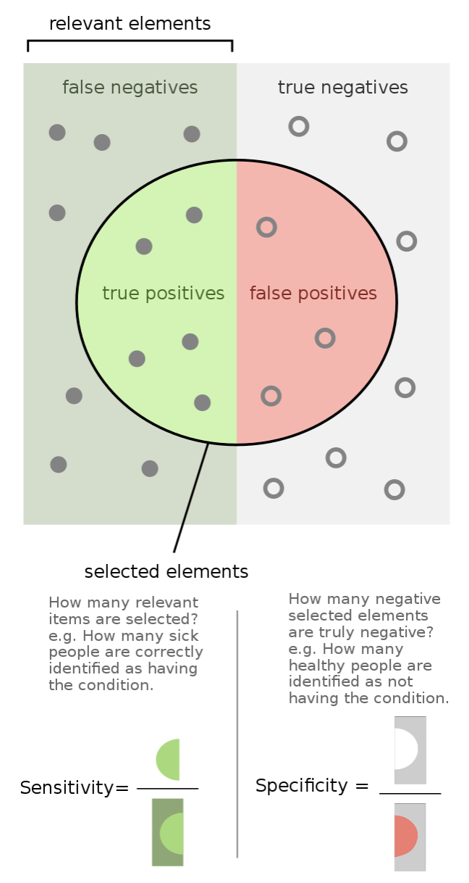
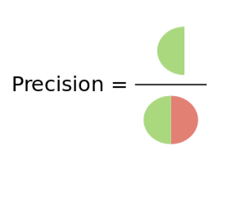
Sensitivity & specificity
Sensitivity: True positive rate
Specificity: True negative rate
Precisision: Positive predictive value
Increasing long kmers
Lower sensitivity
Higher specificity

Slide 10
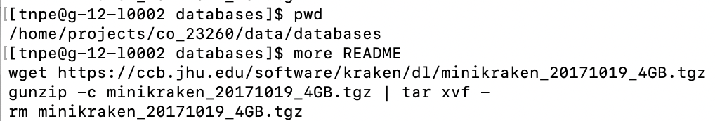
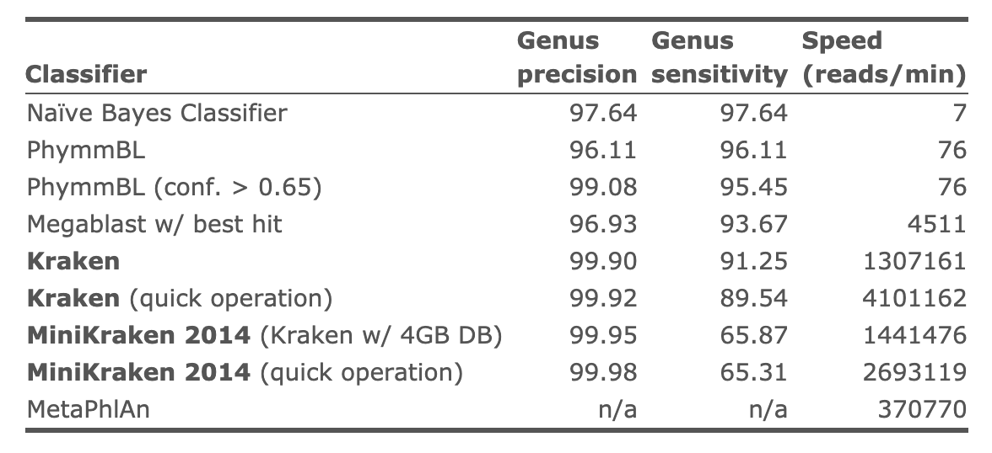
Kraken
https://ccb.jhu.edu/software/kraken/
Notes:
----- Meeting Notes (10/2/13 14:19) -----
When the sequencing is done, you get your output…
----- Meeting Notes (10/2/13 14:27) -----
In this next section I will gow throug the output data.
The sequence data is outputtet as fastq files.
And what is fastq files?
It is a fasta file with quality scores!
So this is an example of a fastq file.

Slide 11
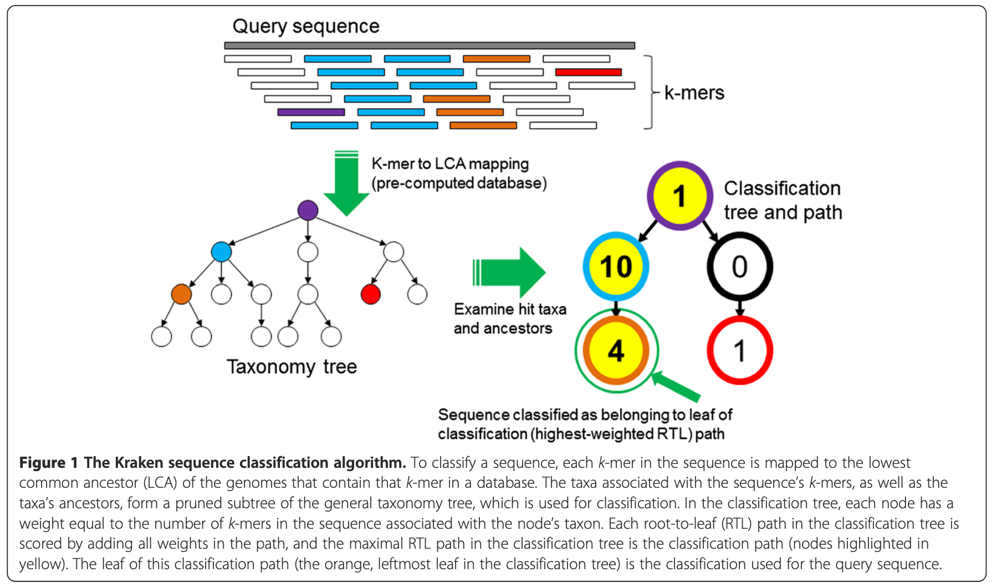
Kraken
Figure copied from Wood and Salzberg Genome Biology 2014, 15:R46

Slide 12
Kraken
Looping over all reads
If a hit is found in database the weight of that node is added by 1
If no hit is found in database then skip that kmer
Once all kmers from a read has been passed sum node values from Root-To-Leaf (RTL)
Assing taxa to read as the maximal RTL path value, leaf with highest RTL value is the taxonomy assignment of that read

Slide 13
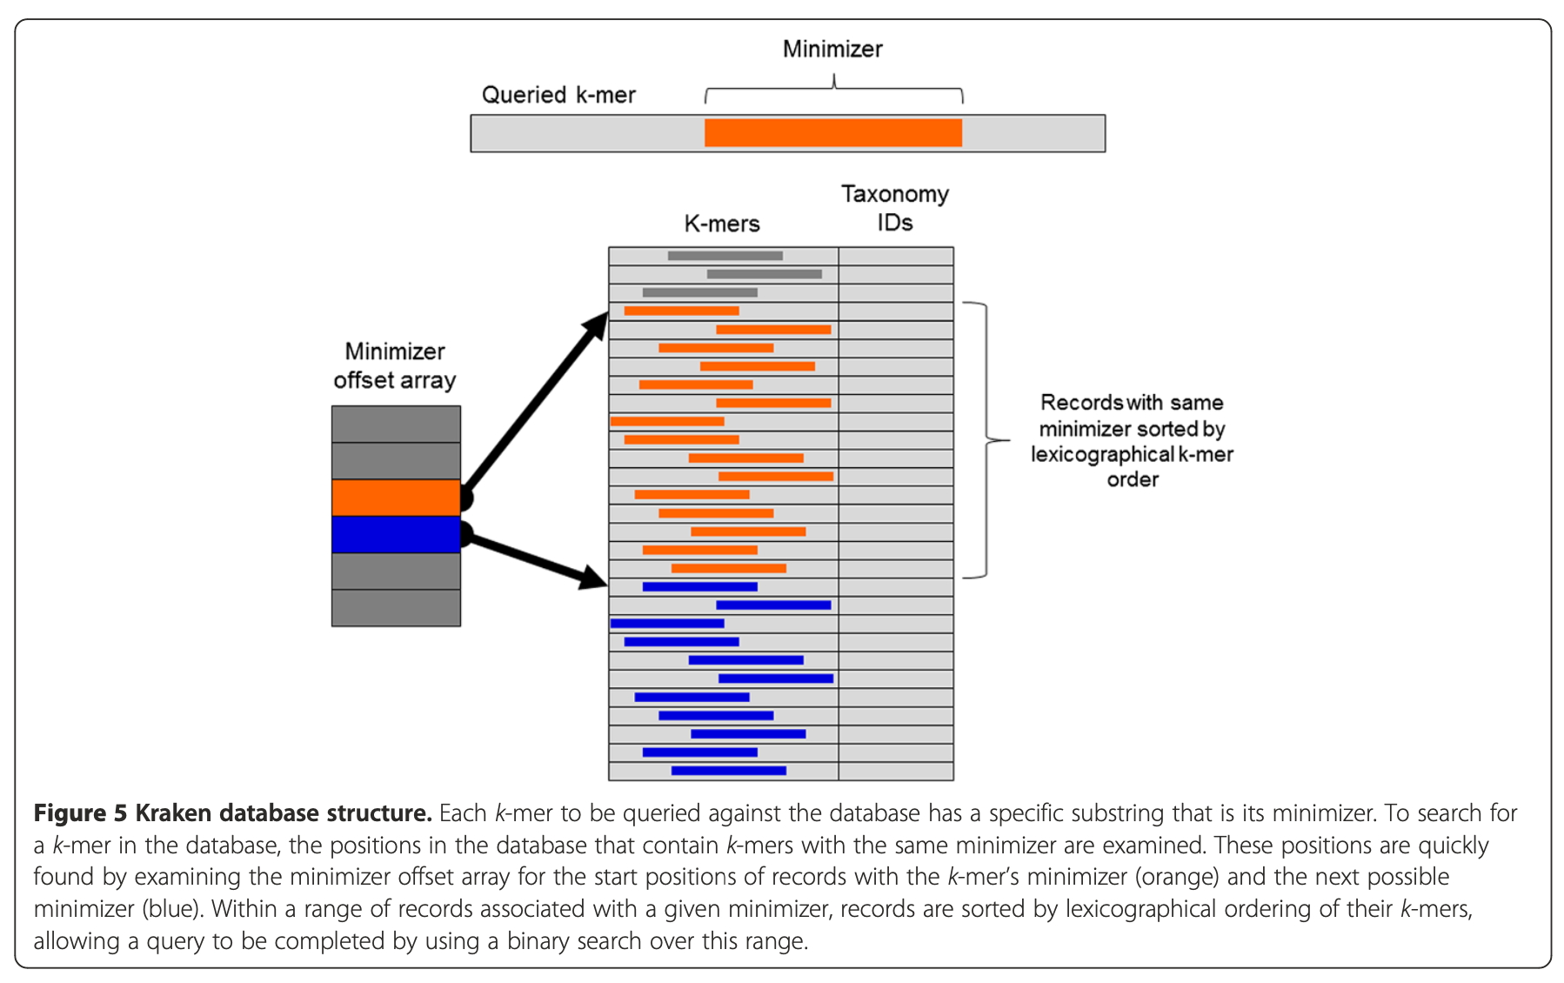
Kraken database
Minimizer examples
Seuences:
ATGCCGA
ATGGGAT
GAATTAA
Pre-sequence (ATG):
CCGA
GGAT
Pre-sequence (GAA):
TTAA
Not kraken
Just example
ATG & GAA are minimizers => reduced memory usage & faster lookup
You can chose to store full kmer and only use minimizer as an fast way to search for full kmer.
Kraken: Process a read in steps of 31-mer
Look for ”minimizer” a 15-mer inside the 31-mer
Lookup 15-mer table for fast search of actual 31-mer and assigning LCA

Slide 14
Kraken database
minimizers
Kmer=31
Minimizer=15

Slide 15
Kraken
In short
Fast method to assign taxonomy to a read via LCA
Database require alot of memory
Reduced database size => reduced taxonomy assignment performance
Default using 31-mers
Good specificity (few false taxonomy assignments)
Ok sensitivity (many read taxonomy assignments correct, but some missing)
Use 15-mer minimizers for improved lookup speed, some improvement in mem usage
If increasing kmer length
More memory usage
Better specificity
Worse sensitivity

Slide 16
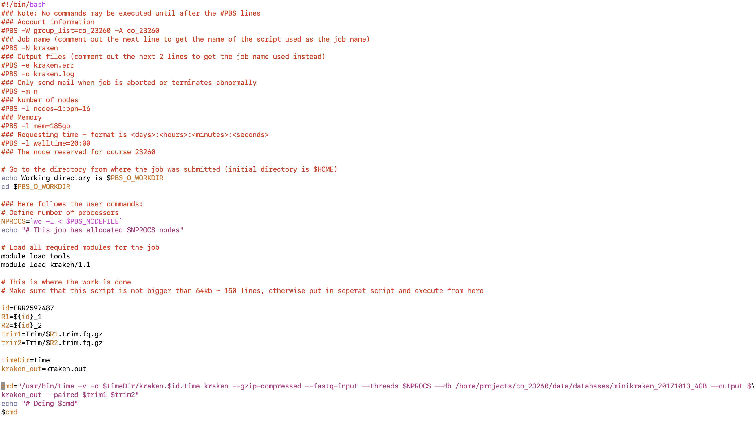
Kraken.pbs.sh

Slide 17
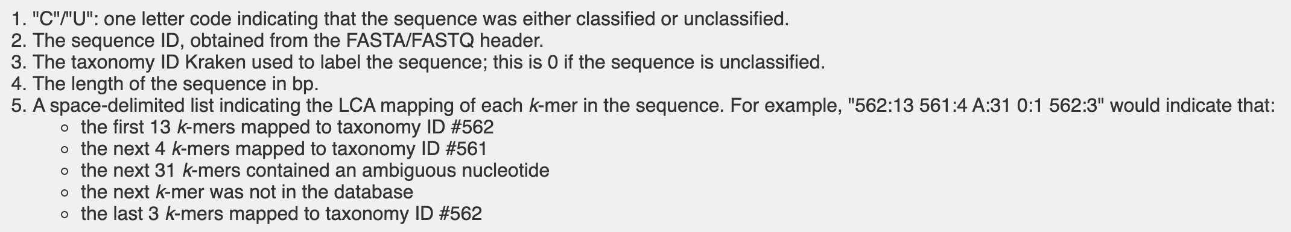
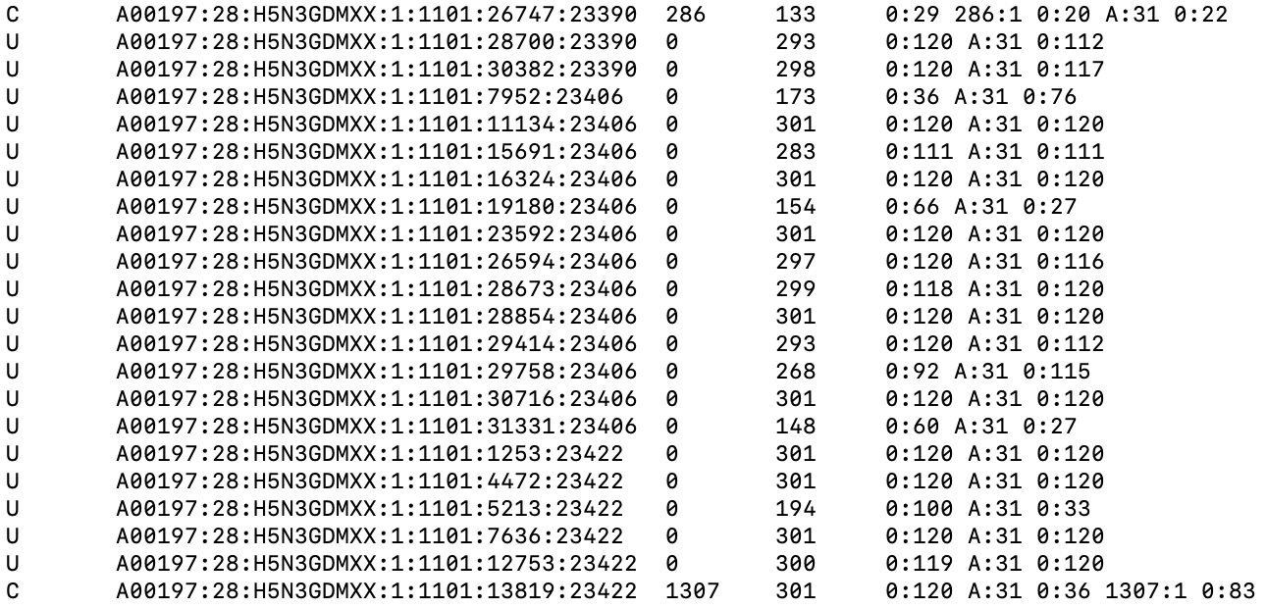
Kraken output
before (not report)
LenS=Kmers+KLen-1

Slide 18
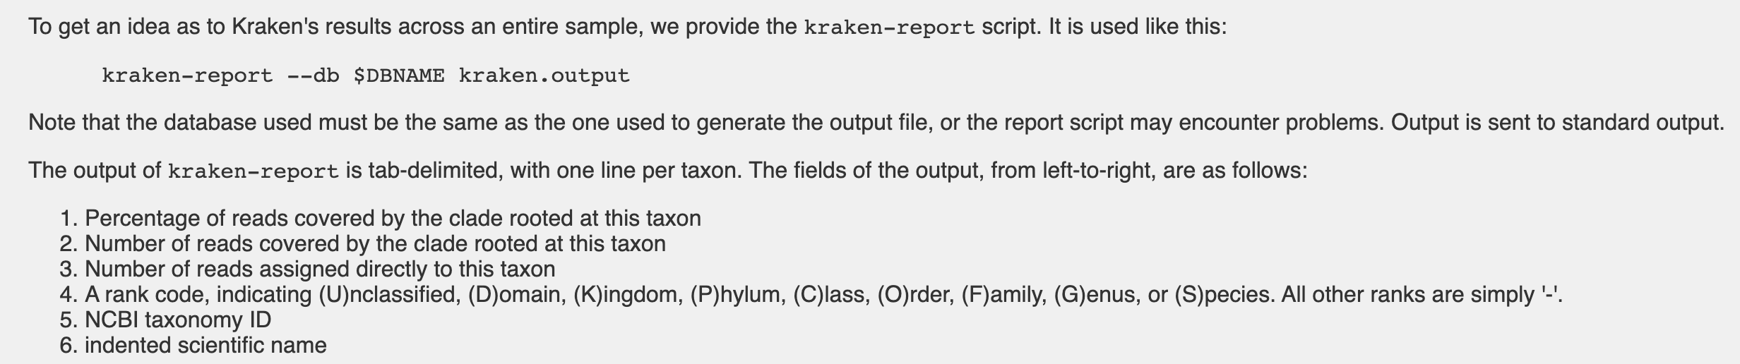
kraken-report
Manuel: https://ccb.jhu.edu/software/kraken/MANUAL.html
kraken-report --db /home/projects/co_23260/data/databases/minikraken_20171013_4GB sequences.kraken > sequences.report
Output from program:

Slide 19
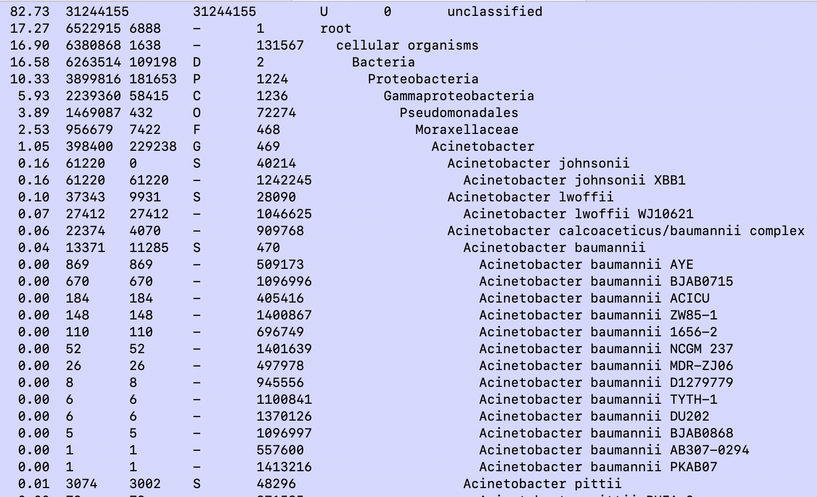
kraken-report
kraken-report --db /home/projects/co_23260/data/databases/minikraken_20171013_4GB sequences.kraken > sequences.report

Slide 20
Kraken (summary)
Figure copied from Wood and Salzberg Genome Biology 2014, 15:R46

Slide 21
15 min break

Slide 22
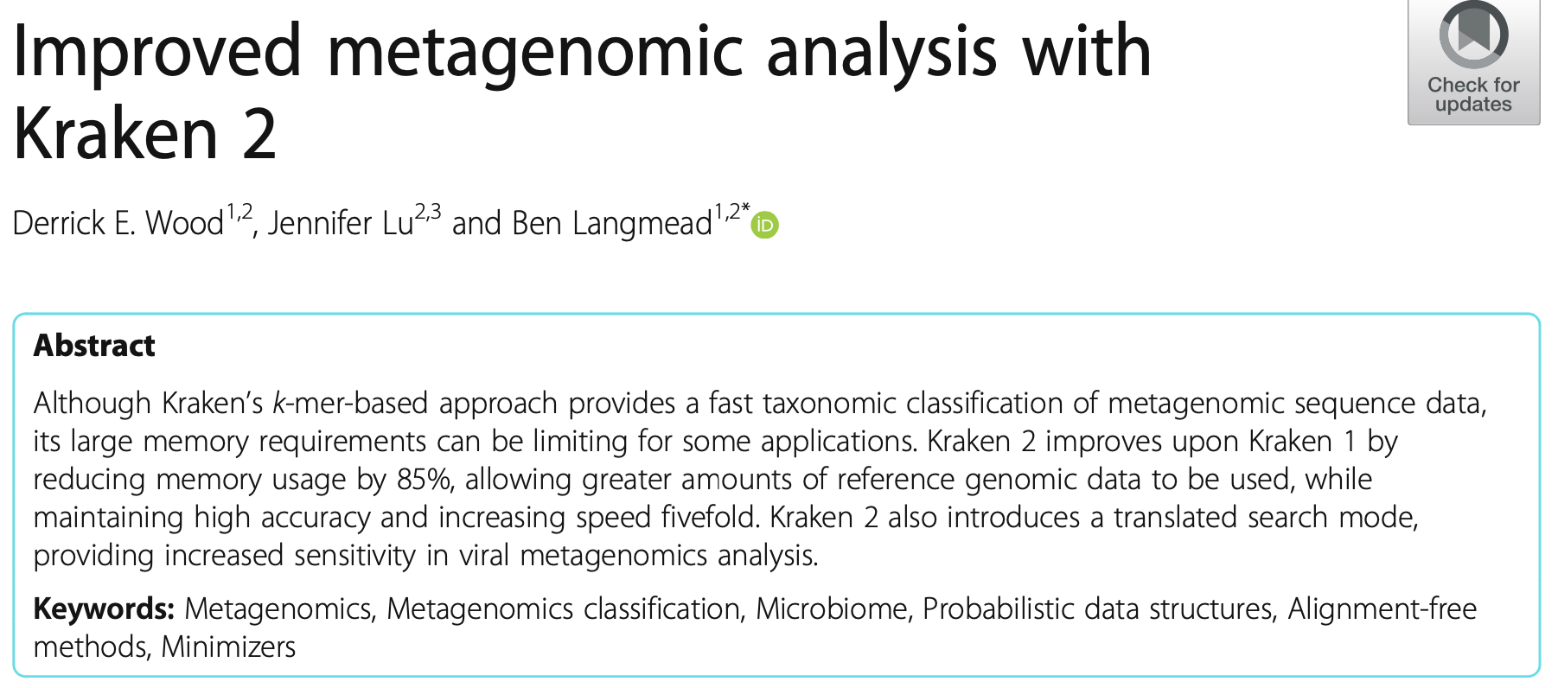
Kraken2
Kraken2 was made to improve on memory usage
Require 85% less memory
Improve sensitivity
Make full use of minimizers
Manuel: https://github.com/DerrickWood/kraken2/wiki/Manual

Slide 23
Kraken
Kraken1
Kmer 31, store entire kmer (minimizer l=15 in lookup)
Database:
>sequence1
ATGTGCCTGTAGTCGTAACTGTGACTATTTGAAATTTTGCTTCATACTTCCATCCTAG
ATGTGCCTGTAGTCGTAACTGTGACTATTTG (Find minimizer l=15)
TGTGCCTGTAGTCGTAACTGTGACTATTTGA (Find minimizer l=15)
GTGCCTGTAGTCGTAACTGTGACTATTTGAA (Find minimizer l=15)
Find minimizer:
ATGTGCCTGTAGTCGTAACTGTGACTATTTG (forward)
CAAATAGTCACAGTTACGACTACAGGCACAT (reverse complement)

Slide 24
Kraken 1
Find minimizer (k=31, l=15)):
ATGTGCCTGTAGTCGTAACTGTGACTATTTG (forward)
CAAATAGTCACAGTTACGACTACAGGCACAT (reverse complement)
ATGTGCCTGTAGTCG
TGTGCCTGTAGTCGT
.
.
CAAATAGTCACAGTT
AAATAGTCACAGTTA
Sort alphabetical => ‘AAATAGTCACAGTTA’ as minimizer
Kraken1 dont really use the minimizer – only faster lookup to find (kmer,LCA )pair
Kraken1 stores the entire kmer (kraken2 only stores the minimizer)

Slide 25
Kraken 2
Find minimizer (k=35, l=31):
TACCATGTGCCTGTAGTCGTAACTGTGACTATTTG (forward, 31-mer)
CAAATAGTCACAGTTACGACTACAGGCACATGGTA (reverse complement)
Find all 31-mers (possible minimizers) Sort alphabetical => ‘AAATAGTCACAGTTACGACTACAGGCACATG’ as minimizer
Mask (s=7)
AAATAGTCACAGTTACGACTACAGGCACATG
AAATAGTCACAGTTACG-C-A-A-G-A-A-G
AAATAGTCACAGTTACGCAAGAAG (31-7=24)
The masking allows for better sensitivity maybe at the cost of specificity and
reduced memory requirements

Slide 26
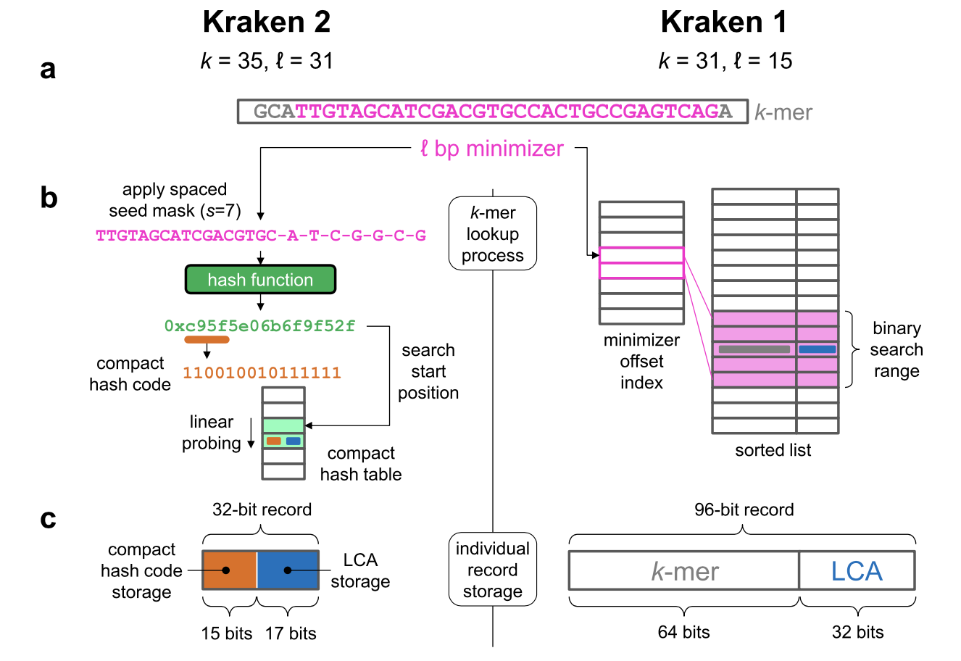
Kraken 1 & 2

Slide 27
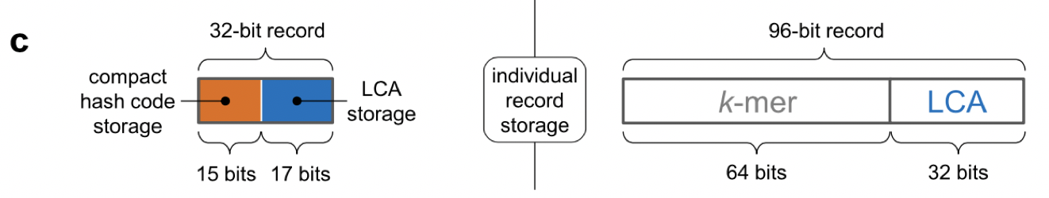
Kraken 1 & 2
32 bits to store a taxid value ! – not really needed 2^32 > 4billion
No taxid number are that big
17 bits = 2^17=131072 so as long as we do not have more taxid values it works
Question: 4 characters (A,T,C,G) how many bits are needed to store 1 nucleotide?
Question: how many bits are needed to store a 24-mer (size of masked minimizer)?
NB! Kraken2 descide to only use 15 bits to store the 24-mer

Slide 28
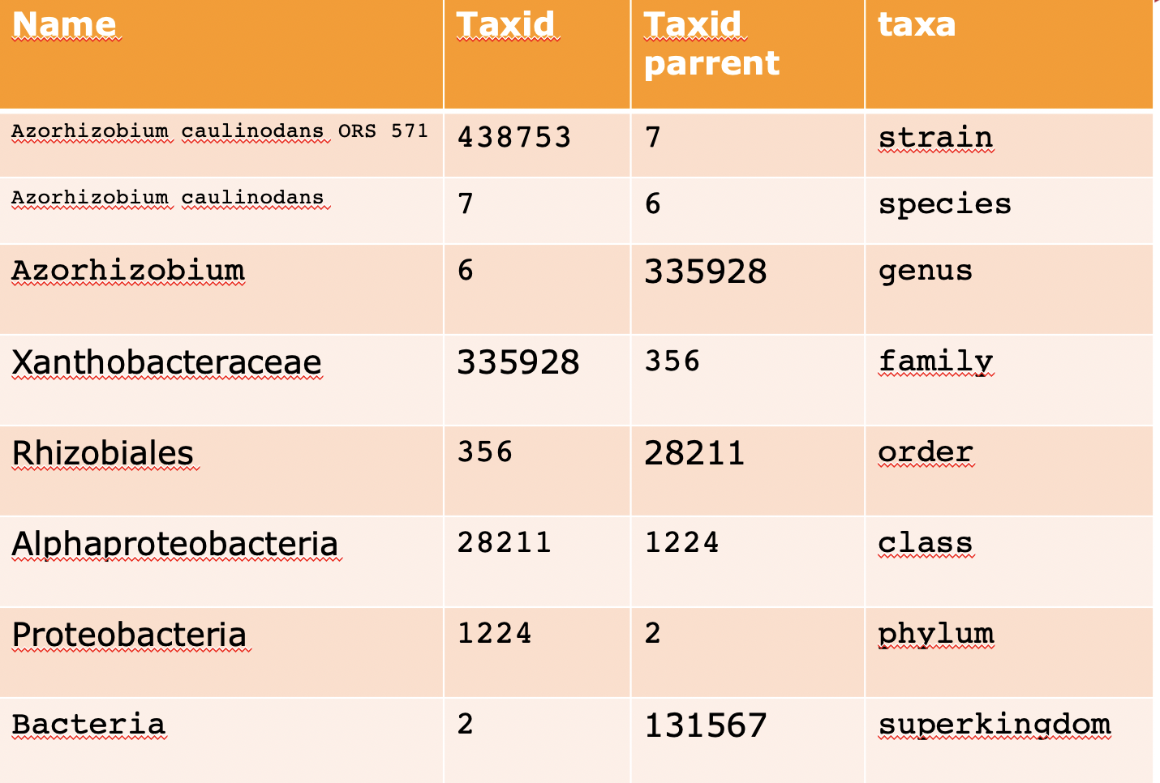
Kraken2
Compact hash code
What you should know about Kraken2 database:
Its probabilistic data structure
If minimizer is not present
100% correct
Minimizer is present
Not 100% correct, we can have False Positive
Presence of a minimizer means we believe the original 35-mer is present and that kmer has a taxonomy assignment (LCA)

Slide 29
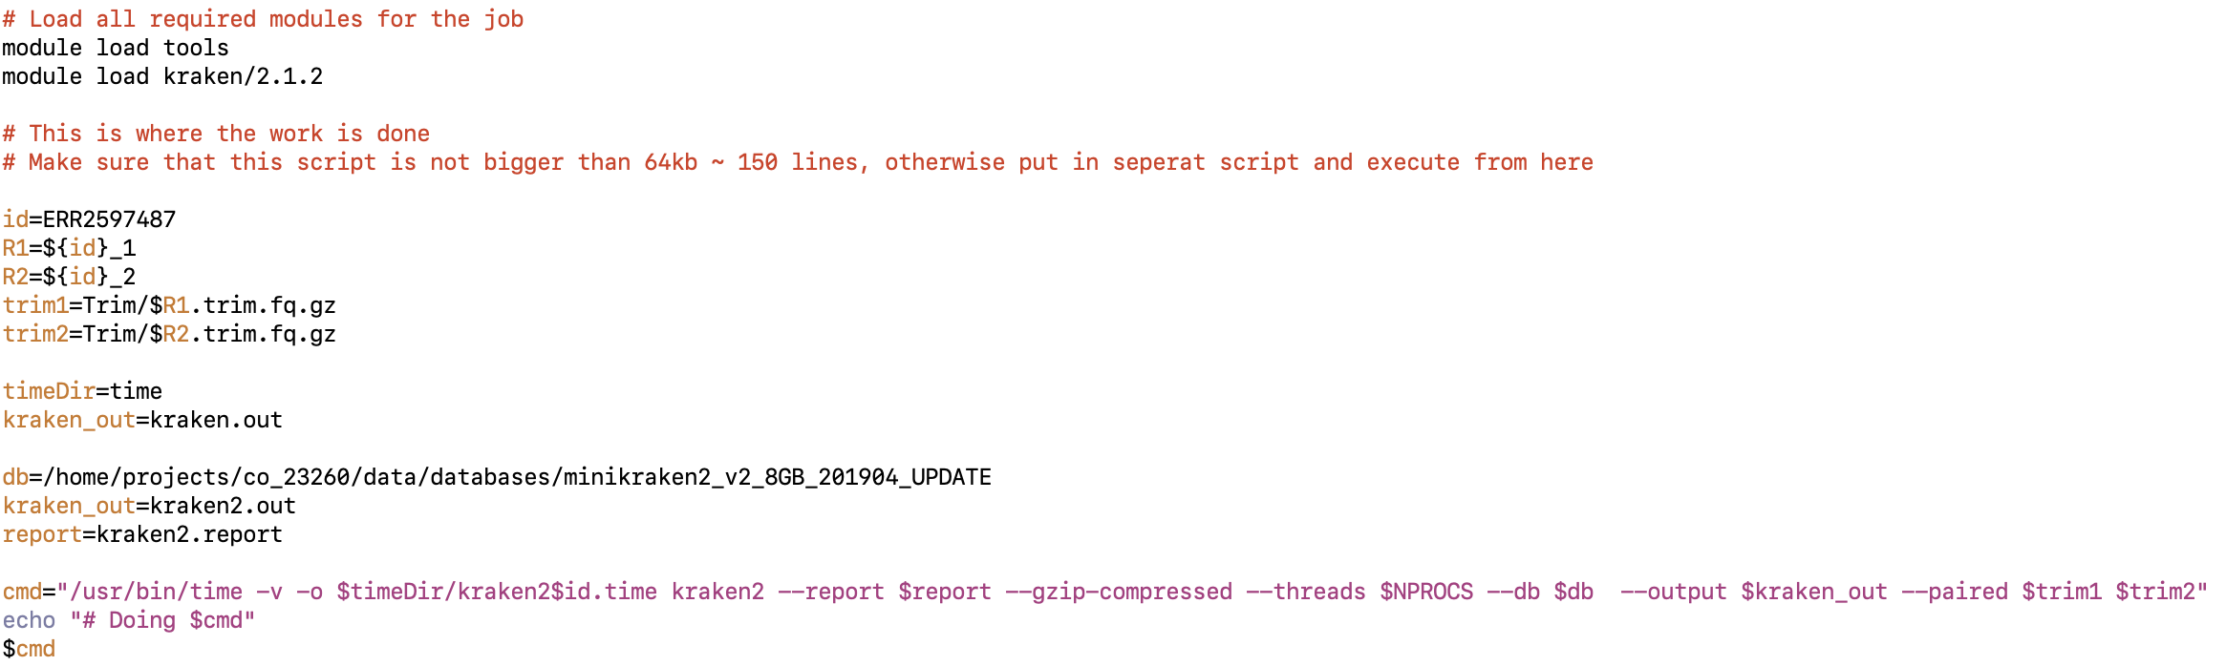
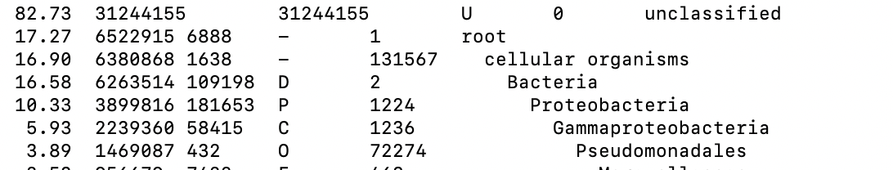
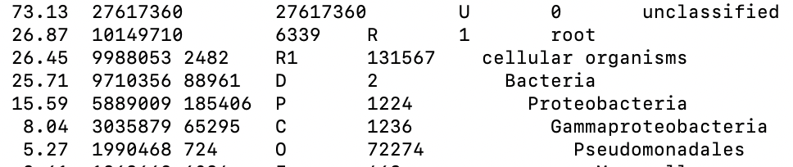
Kraken2
Produce same output as kraken1 (--outfile)
--report option now build-in so no need to run a separate job to make report
kraken1
kraken2

Slide 30
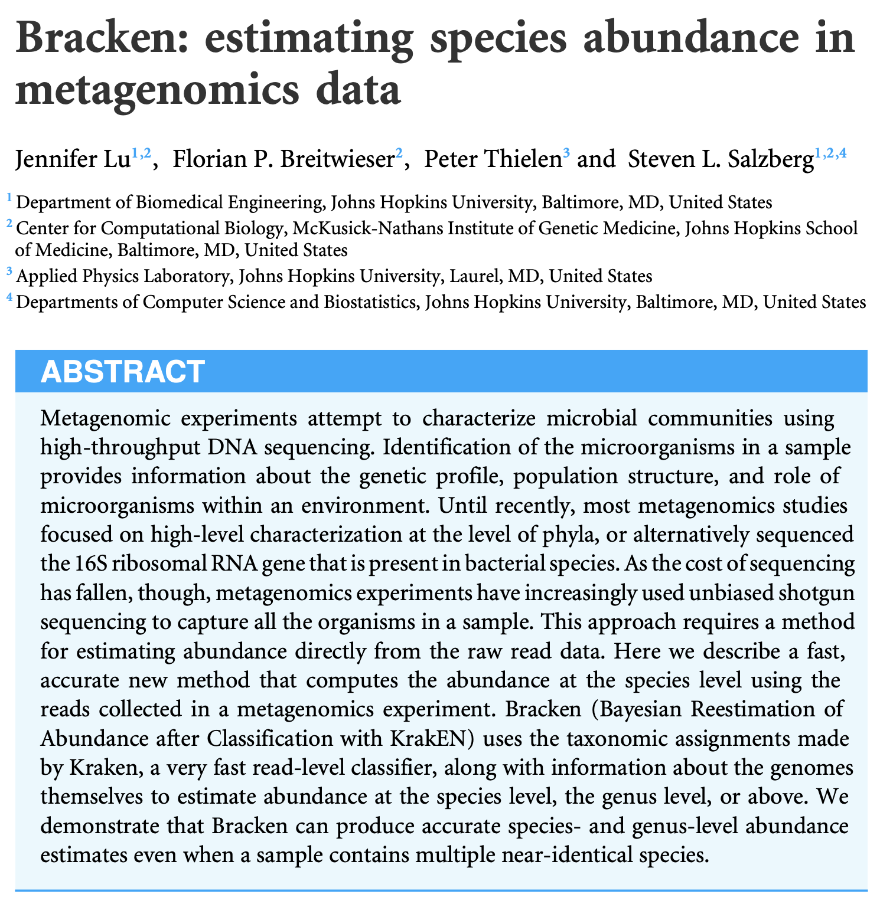
Bracken

Slide 31
Bracken
Reads from experiment:
Read LCA
ATT G
TTG S1
TGT G
GTG S1
TGA G
GAT G
ATG S2
Database
Species1: ATTGTGATT
Species2: ATTATGATG
Re-distribute reads from above
to Genus and reads from Genus
to leafs below?
Genus: 4
Species1: 2
Species2: 1
Abundance S1=2 is underestimated
P(S1|G)=P(G|S1)*P(S1)/P(G)
P(S_{i}|G_{j})=P(G_{j}|S_{i})*P(S_{i})/P(G_{j})

Slide 32
Bracken
Bayesian statistics is beyond to ”need to know” in this course !
Take home message is that bracken use Bayesian statistics
to provide a much better estimation of abundances compared
to Kraken2.
It re-distributes reads from output report made with kraken2

Slide 33
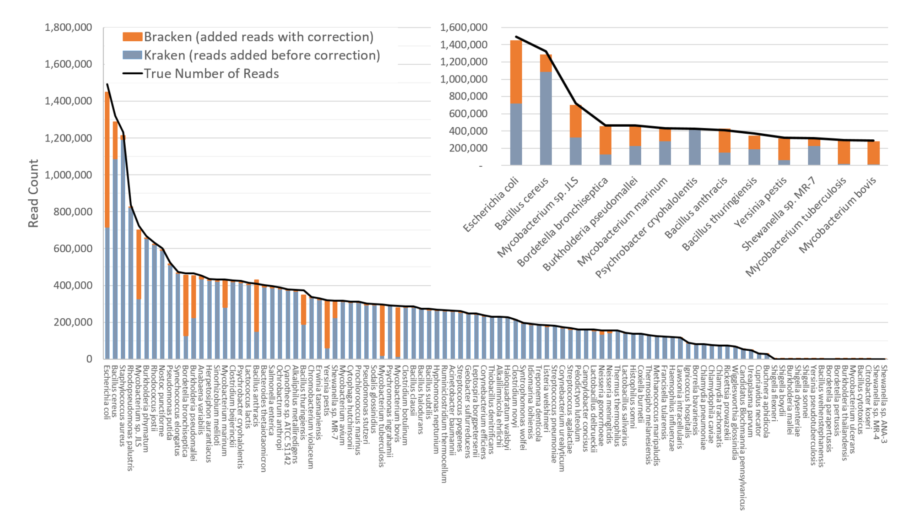
Bracken

Slide 34
Running bracken
Braken runs in like 1 second using output report from kraken2 – no need for qsub
>module load tools
>module load bracken/2.6.2
Usage: bracken -d MY_DB -i INPUT -o OUTPUT -w OUTREPORT -r READ_LEN -l LEVEL -t THRESHOLD
MY_DB location of Kraken database
INPUT Kraken REPORT file to use for abundance estimation
OUTPUT file name for Bracken default output
OUTREPORT New Kraken REPORT output file with Bracken read estimates
READ_LEN read length to get all classifications for (default: 100)
LEVEL level to estimate abundance at [options: D,P,C,O,F,G,S,S1,etc] (default: S)
THRESHOLD number of reads required PRIOR to abundance estimation to perform reestimation (default: 0)
bracken -d /home/projects/co_23260/data/databases/minikraken2_v2_8GB_201904_UPDATE -i kraken2.report
-o bracken.S.out -w bracken.S.report -r 150 -l S -t 10 > bracken.S.summary

Slide 35
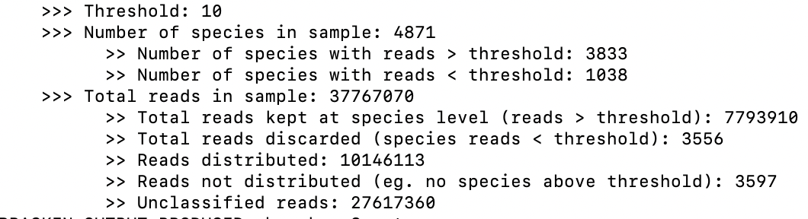
Bracken summary file
bracken -d /home/projects/co_23260/data/databases/minikraken2_v2_8GB_201904_UPDATE -i kraken2.report
-o bracken.S.out -w bracken.S.report -r 150 -l S -t 10 > bracken.S.summary

Slide 36
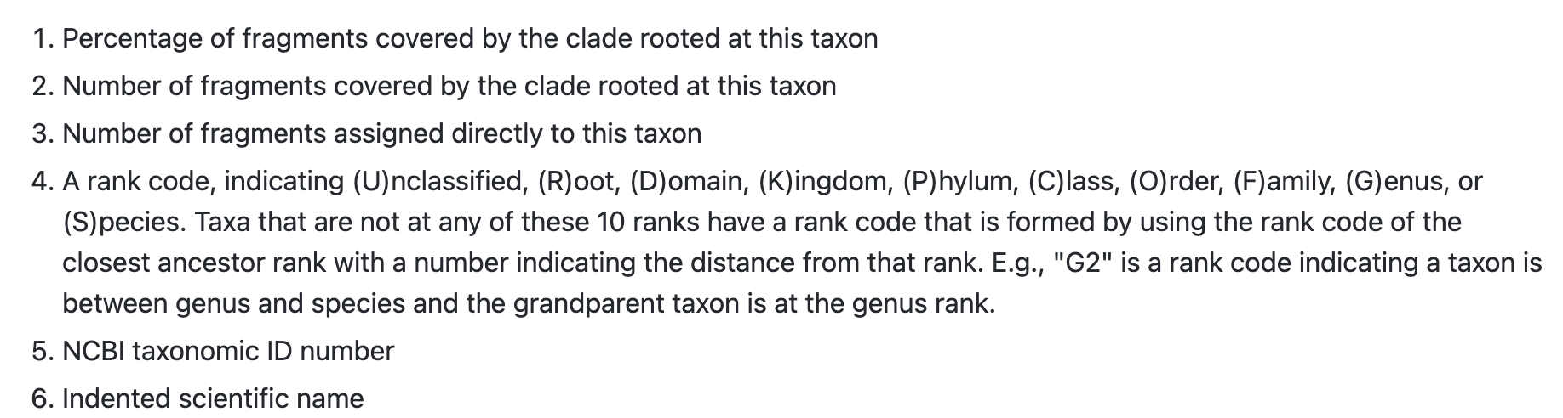
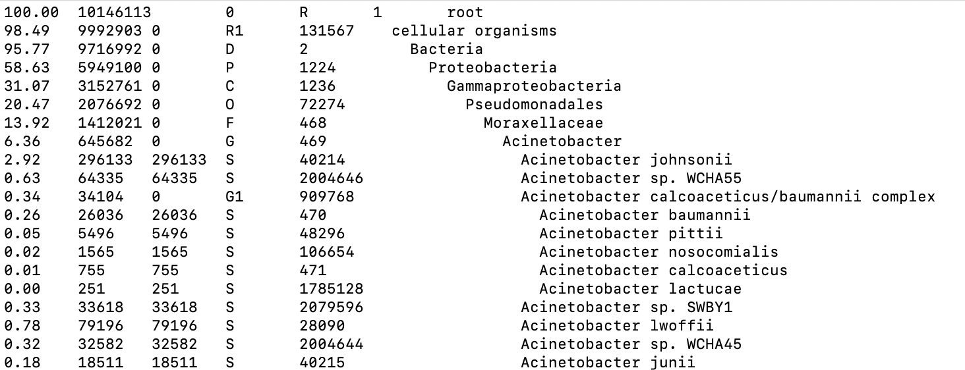
Bracken report file
bracken -d /home/projects/co_23260/data/databases/minikraken2_v2_8GB_201904_UPDATE -i kraken2.report
-o bracken.S.out -w bracken.S.report -r 150 -l S -t 10 > bracken.S.summary

Slide 37
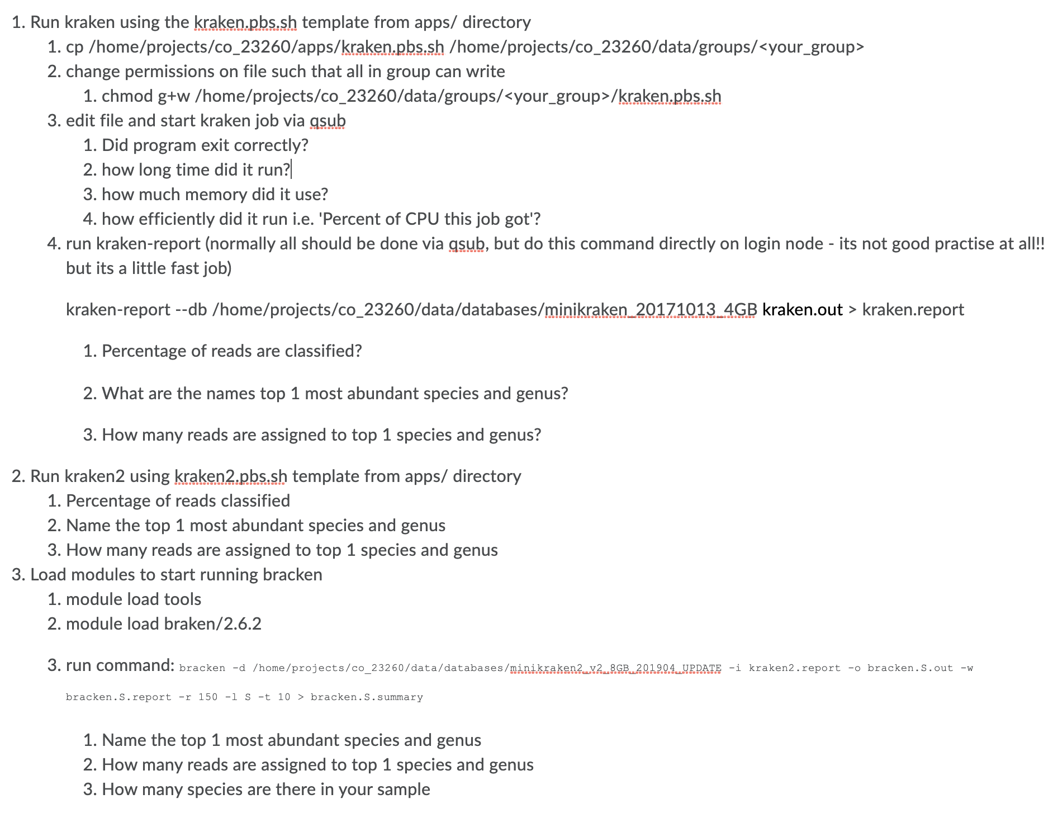
Exercises

